Slide 1
Modern Slavery
a training package for Church Wardens

Slide 2
Short film: What Do You See
https://vimeo.com/273684083 This is a short film giving a few examples of modern slavery in the UK.

Slide 3
The Clewer Initiative film: We See You
https://www.youtube.com/watch?v=I6OddIYjQ-E
Please contact us at clewerinitiative@churchofengland.org if you would like a downloadable copy of the film.

Slide 4
Who are the Clewer Initiative?
The Clewer Initiative is a Church of England project, helping dioceses to raise awareness of modern slavery and provide support and care to the victims.
We believe that the tools to end modern slavery already exist within the local community.
We’re working individually with dioceses across England, supporting them as they explore how they could help end modern slavery in their area.
www.theclewerinitiative.org

Slide 5
Modern Slavery Definition
From the Modern Slavery Act 2015:
Modern Slavery: encompasses slavery, human trafficking, servitude, forced or compulsory labour.
Traffickers and slave masters use whatever means they have at their disposal to coerce, deceive and force individuals into a life of abuse, servitude and inhumane treatment.

Slide 6
What are the different types of exploitation?
labour exploitation
sexual exploitation
domestic servitude
organ harvesting
child sexual exploitation
child criminal exploitation
benefit/financial fraud
forced criminality
debt bondage
forced marriage

Slide 7
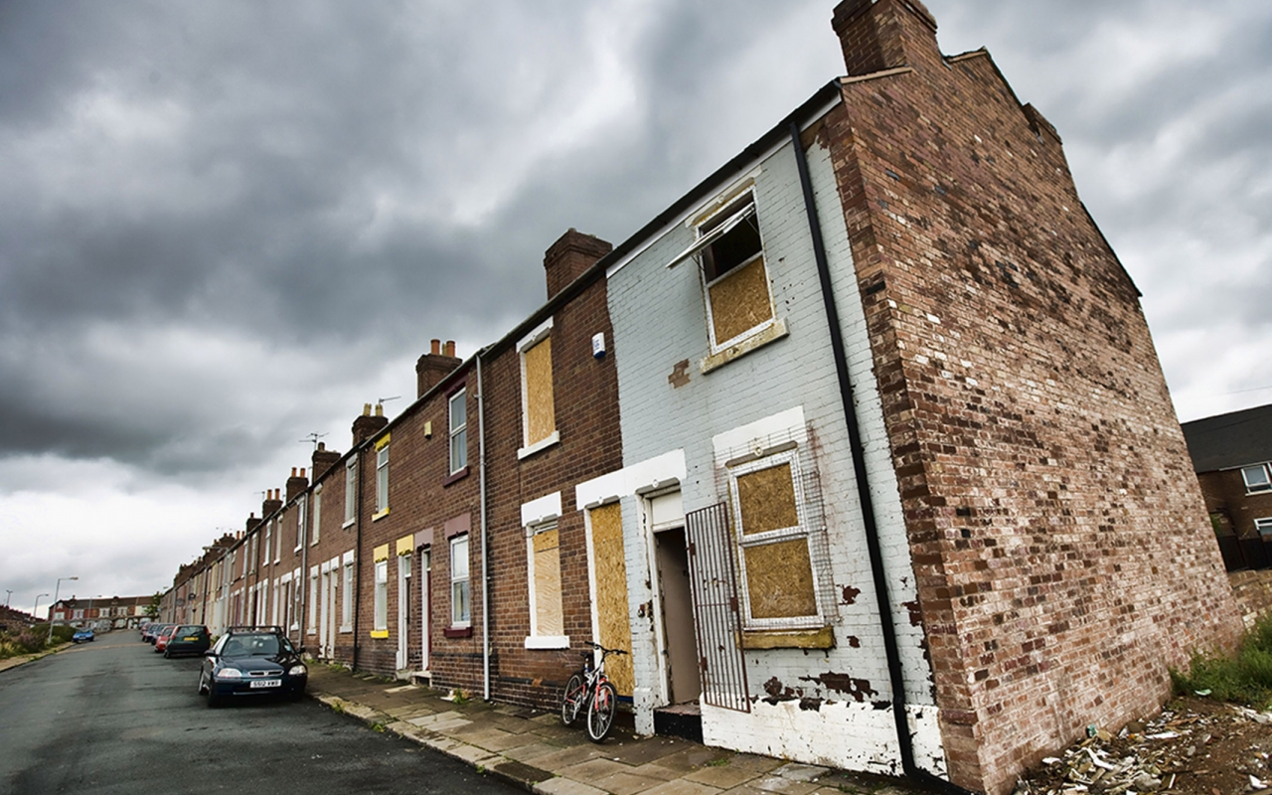
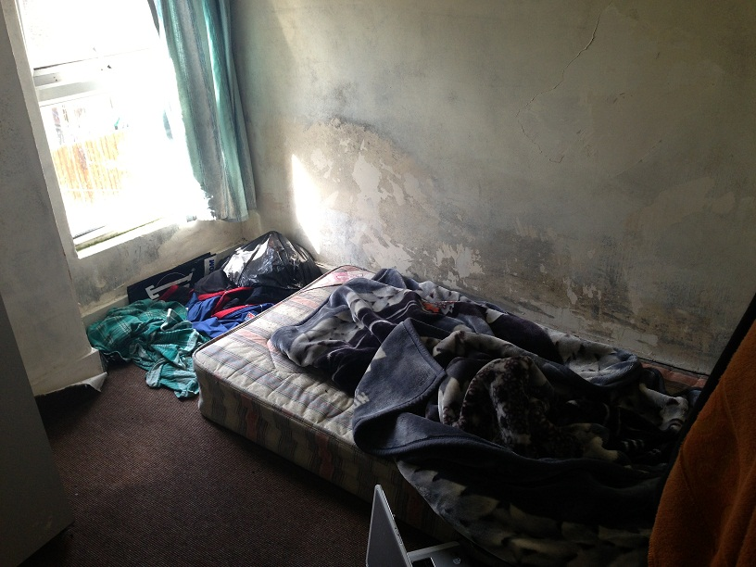
Up to 136,000 victims in the UK*
*According to the Global Slavery Index Report 2018

Slide 8
Potential Victims found in the UK in 2019
10,627 potential victims of modern slavery
5866 adults
4550 minors
3391 (one third) female, 7224 (two thirds) male

Slide 9
Number of NRM referrals 2014-2019

Slide 10
Top 10 nationalities of victims (2019)

Slide 11
What could make a person vulnerable to being trafficked?
lack of opportunity
drug or alcohol dependence
family debt
poverty
discrimination
conflict
mental or physical health
trafficking endemic in area
violence
homelessness

Slide 12
How are they recruited?
family member
boyfriend or partner
acquaintance
stranger
employment agency
smuggling agent

Slide 13
A focus on church wardens

Slide 14
Charlie’s Story
https://www.youtube.com/watch?v=zrJrn25ch04&feature=emb_logo

Slide 15
Spotting the signs
Physical signs:
Physical injuries that appear to be the result of an assault.
Looking malnourished or unkempt.
Appear withdrawn.
Have poor hygiene.
Wear clothes that are not suitable for work and have no protective equipment.
Seem to have one set of clothes they wear every day.

Slide 16
Spotting the signs
Other signs:
Asking for cash only payments.
Seem dependent on drugs or alcohol.
Not know any or very little English.
Seeming unwilling to speak/ hold conversation.
Seeming fearful or anxious.

Slide 17
Spotting the signs
Other signs:
Appearing to be under the control or influence of another person.
Have no access to their identity documents.
Have no access to a mobile phone.
Have very few personal possessions.

Slide 18
How might church wardens come into contact with victims?
Companies that supply regular cleaners and gardeners to church premises.
Companies found in the local directory that may be used for small jobs such as lock smiths, waste disposal, skip hire, removal companies, furniture restorers.
Tradespeople used for basic repairs: plumbers, painters, decorators, electricians, sign makers.
Caterers for church functions.

Slide 19
How might church wardens come into contact with victims?
Hiring companies used for functions such as extra tableware for weddings and funerals.
Cold callers- people who knock on the door offering services such as gardening, repairs, window cleaners, gutter cleaning companies.
Signing contracts with builders for larger building projects such as replacing church roofs or new buildings.

Slide 20
Case study
You employ a cleaning company to clean the church premises. Three workers come to the church who are dropped off by their boss in the morning, they speak very little English and appear to be wearing thin unsuitable clothing despite it being the middle of winter. They do not have any protective clothing or gloves to carry out their work. You offer them a cup of tea, but they do not want to stop working and seem to avoid making eye contact with you. At the end of the day they request to be paid in cash only and are picked up by their boss in the afternoon.

Slide 21
Safeguarding and modern slavery
Modern Slavery is a serious and organised crime, we must be aware of safeguarding surrounding the issue.
Do participate in Clewer safeguarding modules: https://safeguardingtraining.cofeportal.org/
Contact your diocesan safeguarding officer if you have any concerns about modern slavery in your diocese.

Slide 22
What to do if you think you have come across modern slavery
Call 999 if someone is in immediate danger.
Call the Modern Slavery Helpline on 08000 121 700 if you want to report a suspicion or concern.
Ring the GLAA (0800 4320 804) for advice on labour exploitation or to report suspicions.
Ring the police (101) to report suspicions or for advice on local issues.
Record all contact you have had with the individual and any extra information you can think of like license plate numbers.

Slide 23
What to do if you think you have come across modern slavery
NEVER
Make promises to the individual.
Confront the person you suspect is their trafficker or controller.
Try and get them to tell their story or take a ‘formal’ statement, this could jeopardise evidence and put them in danger.

Slide 24
The numbers to call
999
If someone is in immediate danger.
101
For advice about local issues.
To report suspicions.
0800 0121 700
To call the Modern Slavery Helpline.
To report suspicions or concerns or ask for advice.
0800 4320 804
To call the Gangmasters and Labour Abuse Authority.
For advice on labour exploitation or to report suspicions.

Slide 25
Further resources: raising awareness
The Clewer Initiative has loads of posters, leaflets, and awareness raising materials available to download from their website: www.theclewerinitiative.org/resources.
Find posters and leaflets in 19 different languages on the GLAA website: www.gla.gov.uk/publications/resources/.

Slide 26
Any questions?
What to do if you suspect someone is a victim of modern slavery:
In an emergency call 999
Report concerns to the Modern Slavery Helpline: 08000 121 700
Sign up to The Clewer Initiative newsletter at: http://eepurl.com/cQfZYT

